Slide 1
W4111 – Introduction to Databases Section 002, Spring 2024 Lecture 12 Module II (5), NoSQL (5), Big Data
© Donald F. Ferguson, 2024

Slide 2
W4111 – Introduction to Databases Section 002, Spring 2024 Lecture 12 Module II (5), NoSQL (5), Big Data
We will start in a couple of minutes.
© Donald F. Ferguson, 2024

Slide 3

Reminder
3 | COMS W4111_002_2024_1 - Lecture 12: Module II (5), NoSQL (5), Big Data © Donald F. Ferguson, 2024

Slide 4
Modules
Each section of W4111 is slightly different based on student interest and professor's focus. There is a common, core syllabus. Professors cover topics in different orders and grouping based on teaching style.
This section of W4111 has four modules:
Foundational concepts (50% of semester): This module covers concepts like data models, relational model, relational databases and applications, schema, normalization, … The module focuses on the relational model and relational databases. The concepts are critical and foundational for all types of databases and data centric applications.
Database management system architecture and implementation (10%): This module covers the software architecture, algorithms and implementation techniques that allow databases management systems to deliver functions. Topics include memory hierarchy, storage systems, caching/buffer pools, indexes, query processing, query optimization, transaction processing, isolation and concurrency control.
NoSQL – “Not Only SQL” databases (20%): This module provides motivation for “NoSQL” data models and databases, and covers examples and use cases. The module also includes cloud databases and databases-as-a-service.
Data Enabled Decision Support (20%): This module covers data warehouses, data import and cleanse, OLAP, Pivot Tables, Star Schema, reporting and visualization, and provides and overview of analysis techniques, e.g. clustering, classification, analysis, mining.

Slide 5
Module II, Part 5
5 | COMS W4111_002_2024_1 - Lecture 12: Module II (5), NoSQL (5), Big Data © Donald F. Ferguson, 2024

Slide 6

Reminder
6 | COMS W4111_002_2024_1 - Lecture 12: Module II (5), NoSQL (5), Big Data © Donald F. Ferguson, 2024

Slide 7

Transactions
Find things quickly.
Load/Save quickly.
Transactions
Durability
Database Systems: The Complete Book (2nd Edition) by Hector Garcia-Molina (Author), Jeffrey D. Ullman (Author), Jennifer Widom (Author)

Slide 8
Locking
Transactions Isolation Recovery

Slide 9
Lock-Based Protocols
A lock is a mechanism to control concurrent access to a data item
Data items can be locked in two modes :
1. exclusive (X) mode. Data item can be both read as well as
written. X-lock is requested using lock-X instruction.
2. shared (S) mode. Data item can only be read. S-lock is
requested using lock-S instruction.
Lock requests are made to concurrency-control manager. Transaction can proceed only after request is granted.

Slide 10
Lock-Based Protocols (Cont.)
Lock-compatibility matrix
A transaction may be granted a lock on an item if the requested lock is compatible with locks already held on the item by other transactions
Any number of transactions can hold shared locks on an item,
But if any transaction holds an exclusive on the item no other transaction may hold any lock on the item.
Notes:
If a lock cannot be granted, the requesting transaction is made to wait till all incompatible locks held by other transactions have been released. The lock is then granted.

Slide 11
Lock-Based Protocols (Cont.)
Example of a transaction performing locking:
T₂: lock-S(A);
read (A);
unlock(A);
lock-S(B);
read (B);
unlock(B);
display(A+B)
Locking as above is not sufficient to guarantee serializability

Slide 12
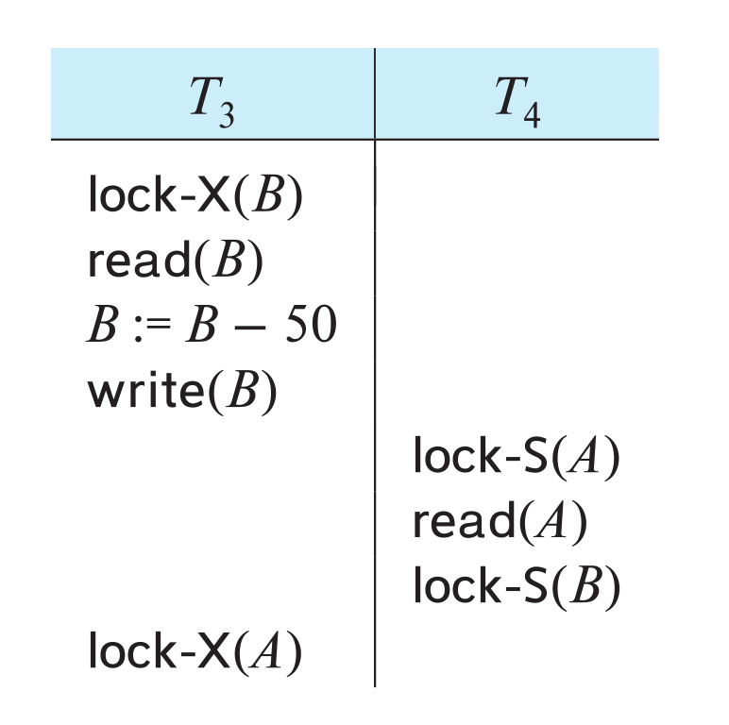
Deadlock
Consider the partial schedule
Neither T₃ nor T₄ can make progress — executing lock-S(B) causes T₄ to wait for T₃ to release its lock on B, while executing lock-X(A) causes T₃ to wait for T₄ to release its lock on A.
Such a situation is called a deadlock.
To handle a deadlock one of T₃ or T₄ must be rolled back and its locks released.

Slide 13
Deadlock (Cont.)
The potential for deadlock exists in most locking protocols. Deadlocks are a necessary evil.
Starvation is also possible if concurrency control manager is badly designed. For example:
A transaction may be waiting for an X-lock on an item, while a sequence of other transactions request and are granted an S-lock on the same item.
The same transaction is repeatedly rolled back due to deadlocks.
Concurrency control manager can be designed to prevent starvation.

Slide 14
The Two-Phase Locking Protocol
A protocol which ensures conflict-serializable schedules.
Phase 1: Growing Phase
Transaction may obtain locks
Transaction may not release locks
Phase 2: Shrinking Phase
Transaction may release locks
Transaction may not obtain locks
The protocol assures serializability. It can be proved that the transactions can be serialized in the order of their lock points (i.e., the point where a transaction acquired its final lock).
Locks
Time

Slide 15
The Two-Phase Locking Protocol (Cont.)
Two-phase locking does not ensure freedom from deadlocks
Extensions to basic two-phase locking needed to ensure recoverability of freedom from cascading roll-back
Strict two-phase locking: a transaction must hold all its exclusive locks till it commits/aborts.
Ensures recoverability and avoids cascading roll-backs
Rigorous two-phase locking: a transaction must hold all locks till commit/abort.
Transactions can be serialized in the order in which they commit.
Most databases implement rigorous two-phase locking, but refer to it as simply two-phase locking

Slide 16
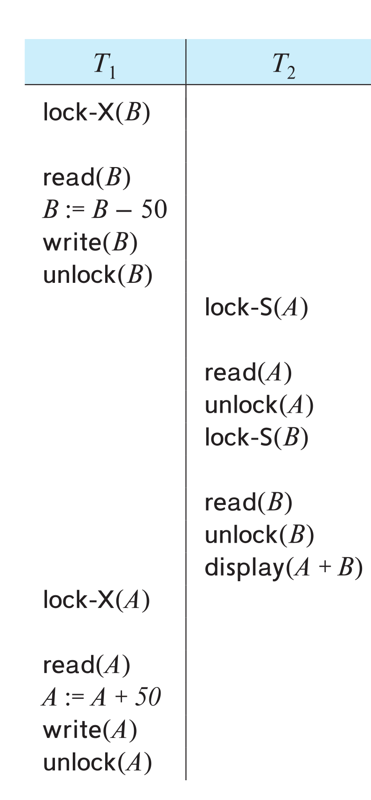
The Two-Phase Locking Protocol (Cont.)
Two-phase locking is not a necessary condition for serializability
There are conflict serializable schedules that cannot be obtained if the two-phase locking protocol is used.
In the absence of extra information (e.g., ordering of access to data), two-phase locking is necessary for conflict serializability in the following sense:
Given a transaction T_{i} that does not follow two-phase locking, we can find a transaction T_{j} that uses two-phase locking, and a schedule for T_{i} and T_{j} that is not conflict serializable.

Slide 17
Locking Protocols
Given a locking protocol (such as 2PL)
A schedule S is legal under a locking protocol if it can be generated by a set of transactions that follow the protocol
A protocol ensures serializability if all legal schedules under that protocol are serializable

Slide 18
Lock Conversions
Two-phase locking protocol with lock conversions:
– Growing Phase:
can acquire a lock-S on item
can acquire a lock-X on item
can convert a lock-S to a lock-X (upgrade)
– Shrinking Phase:
can release a lock-S
can release a lock-X
can convert a lock-X to a lock-S (downgrade)
This protocol ensures serializability

Slide 19
Automatic Acquisition of Locks
A transaction T_{i} issues the standard read/write instruction, without explicit locking calls.
The operation read(D) is processed as:
if T_{i} has a lock on D
then
read(D)
else begin
if necessary wait until no other
transaction has a lock-X on D
grant T_{i} a lock-S on D;
read(D)
end

Slide 20
Automatic Acquisition of Locks (Cont.)
The operation write(D) is processed as:
if T_{i} has a lock-X on D
then
write(D)
else begin
if necessary wait until no other trans. has any lock on D,
if T_{i} has a lock-S on D
then
upgrade lock on D to lock-X
else
grant T_{i} a lock-X on D
write(D)
end;
All locks are released after commit or abort

Slide 21
Implementation of Locking
A lock manager can be implemented as a separate process
Transactions can send lock and unlock requests as messages
The lock manager replies to a lock request by sending a lock grant messages (or a message asking the transaction to roll back, in case of a deadlock)
The requesting transaction waits until its request is answered
The lock manager maintains an in-memory data-structure called a lock table to record granted locks and pending requests

Slide 22
Deadlock Handling
System is deadlocked if there is a set of transactions such that every transaction in the set is waiting for another transaction in the set.

Slide 23
Deadlock Handling
Deadlock prevention protocols ensure that the system will never enter into a deadlock state. Some prevention strategies:
Require that each transaction locks all its data items before it begins execution (pre-declaration).
Impose partial ordering of all data items and require that a transaction can lock data items only in the order specified by the partial order (graph-based protocol).

Slide 24
More Deadlock Prevention Strategies
wait-die scheme — non-preemptive
Older transaction may wait for younger one to release data item.
Younger transactions never wait for older ones; they are rolled back instead.
A transaction may die several times before acquiring a lock
wound-wait scheme — preemptive
Older transaction wounds (forces rollback) of younger transaction instead of waiting for it.
Younger transactions may wait for older ones.
Fewer rollbacks than wait-die scheme.
In both schemes, a rolled back transactions is restarted with its original timestamp.
Ensures that older transactions have precedence over newer ones, and starvation is thus avoided.

Slide 25
Deadlock prevention (Cont.)
Timeout-Based Schemes:
A transaction waits for a lock only for a specified amount of time. After that, the wait times out and the transaction is rolled back.
Ensures that deadlocks get resolved by timeout if they occur
Simple to implement
But may roll back transaction unnecessarily in absence of deadlock
Difficult to determine good value of the timeout interval.
Starvation is also possible

Slide 26
Deadlock Detection
Wait-for graph
Vertices: transactions
Edge from T_{i} →T_{j}. : if T_{i} is waiting for a lock held in conflicting mode byT_{j}
The system is in a deadlock state if and only if the wait-for graph has a cycle.
Invoke a deadlock-detection algorithm periodically to look for cycles.
Wait-for graph without a cycle
Wait-for graph with a cycle

Slide 27
Deadlock Recovery
When deadlock is detected :
Some transaction will have to rolled back (made a victim) to break deadlock cycle.
Select that transaction as victim that will incur minimum cost
Rollback -- determine how far to roll back transaction
Total rollback: Abort the transaction and then restart it.
Partial rollback: Roll back victim transaction only as far as necessary to release locks that another transaction in cycle is waiting for
Starvation can happen (why?)
One solution: oldest transaction in the deadlock set is never chosen as victim

Slide 28
Schedules, Serializable
Transactions Isolation Recovery

Slide 29
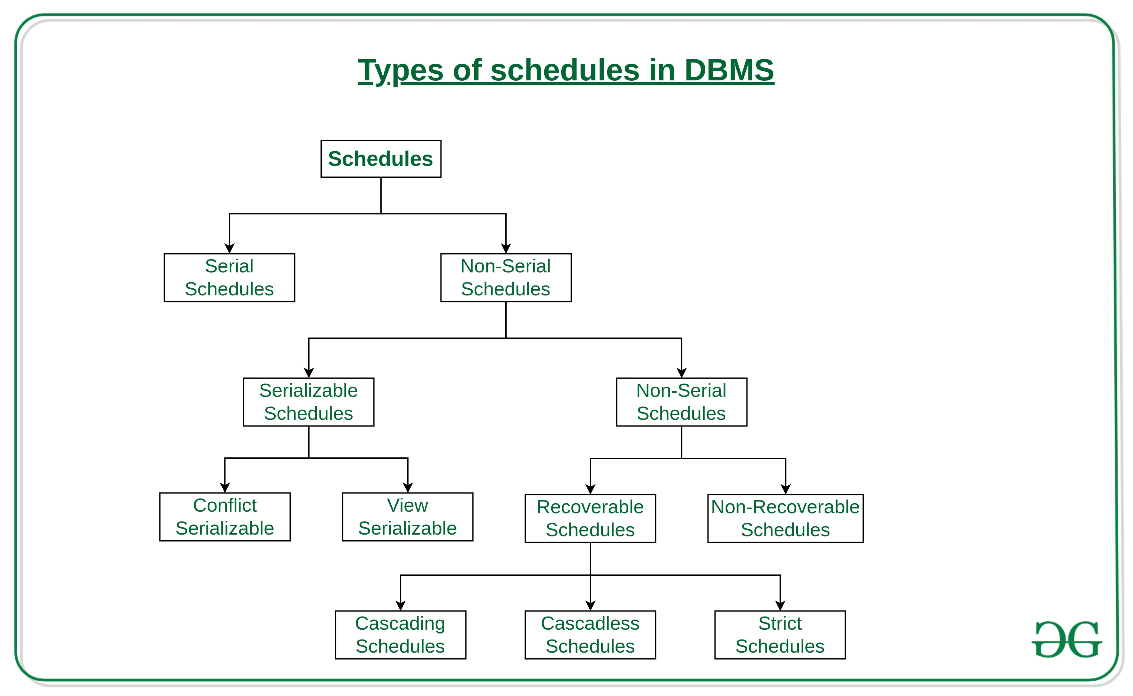
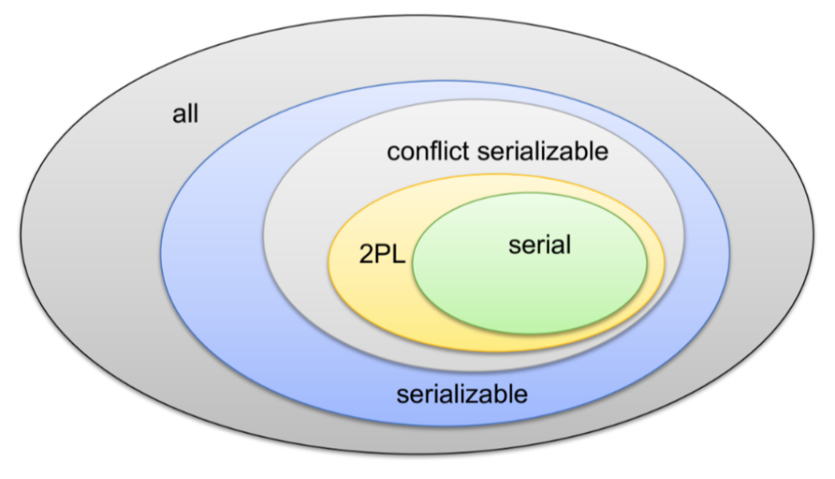
Schedules and Serializable
We covered serial schedules, 2PL and serializable in the previous lecture.
The types of schedules are much more complex.
There are also forms of conflict management and lock types other than R/W.
We will talk a little bit about them for awareness.
These are academically interesting but do not come up in practice.

Slide 30
Serializability
Basic Assumption – Each transaction preserves database consistency.
Thus, serial execution of a set of transactions preserves database consistency.
A (possibly concurrent) schedule is serializable if it is equivalent to a serial schedule. Different forms of schedule equivalence give rise to the notions of:
1. Conflict serializability
2. View serializability

Slide 31
Simplified view of transactions
We ignore operations other than read and write instructions
We assume that transactions may perform arbitrary computations on data in local buffers in between reads and writes.
Our simplified schedules consist of only read and write instructions.

Slide 32
Conflicting Instructions
Instructions l_{i} and l_{j} of transactions T_{i} and T_{j} respectively, conflict if and only if there exists some item Q accessed by both l_{i} and l_{j}, and at least one of these instructions wrote Q.
1. l_{i} = read(Q), l_{j} = read(Q). l_{i} and l_{j} don’t conflict. 2. l_{i} = read(Q), l_{j} = write(Q). They conflict. 3. l_{i} = write(Q), l_{j} = read(Q). They conflict 4. l_{i} = write(Q), l_{j} = write(Q). They conflict
Intuitively, a conflict between l_{i} and l_{j} forces a (logical) temporal order between them.
If l_{i} and l_{j} are consecutive in a schedule and they do not conflict, their results would remain the same even if they had been interchanged in the schedule.

Slide 33
Conflict Serializability
If a schedule S can be transformed into a schedule S’ by a series of swaps of non-conflicting instructions, we say that S and S’ are conflict equivalent.
We say that a schedule S is conflict serializable if it is conflict equivalent to a serial schedule

Slide 34
Conflict Serializability (Cont.)
Schedule 3 can be transformed into Schedule 6, a serial schedule where T₂ follows T₁, by series of swaps of non-conflicting instructions. Therefore Schedule 3 is conflict serializable.
Schedule 3
Schedule 6

Slide 35
Conflict Serializability (Cont.)
Example of a schedule that is not conflict serializable:
We are unable to swap instructions in the above schedule to obtain either the serial schedule < T₃, T₄ >, or the serial schedule < T₄, T₃ >.

Slide 36
View Serializability
Let S and S’ be two schedules with the same set of transactions. S and S’ are view equivalent if the following three conditions are met, for each data item Q,
1. If in schedule S, transaction T_{i} reads the initial value of Q, then in
schedule S’ also transaction T_{i} must read the initial value of Q.
2. If in schedule S transaction T_{i} executes read(Q), and that value was
produced by transaction T_{j} (if any), then in schedule S’ also
transaction T_{i} must read the value of Q that was produced by the
same write(Q) operation of transaction T_{j} .
3. The transaction (if any) that performs the final write(Q) operation in
schedule S must also perform the final write(Q) operation in schedule S’.
As can be seen, view equivalence is also based purely on reads and writes alone.

Slide 37
View Serializability (Cont.)
A schedule S is view serializable if it is view equivalent to a serial schedule.
Every conflict serializable schedule is also view serializable.
Below is a schedule which is view-serializable but not conflict serializable.
What serial schedule is above equivalent to?
Every view serializable schedule that is not conflict serializable has blind writes.

Slide 38
Testing for Serializability
Consider some schedule of a set of transactions T₁, T₂, ..., T_{n}
Precedence graph — a direct graph where the vertices are the transactions (names).
We draw an arc from T_{i} to T_{j} if the two transaction conflict, and T_{i} accessed the data item on which the conflict arose earlier.
We may label the arc by the item that was accessed.
Example of a precedence graph

Slide 39
Test for Conflict Serializability
A schedule is conflict serializable if and only if its precedence graph is acyclic.
Cycle-detection algorithms exist which take order n² time, where n is the number of vertices in the graph.
(Better algorithms take order n + e where e is the number of edges.)
If precedence graph is acyclic, the serializability order can be obtained by a topological sorting of the graph.
This is a linear order consistent with the partial order of the graph.
For example, a serializability order for Schedule A would be T₅ → T₁ → T₃ → T₂ → T₄
Are there others?

Slide 40
Recoverable Schedules
Need to address the effect of transaction failures on concurrently running transactions.
Recoverable schedule — if a transaction T_{j} reads a data item previously written by a transaction T_{i} , then the commit operation of T_{i} appears before the commit operation of T_{j}.
The following schedule (Schedule 11) is not recoverable
If T₈ should abort, T₉ would have read (and possibly shown to the user) an inconsistent database state. Hence, database must ensure that schedules are recoverable.

Slide 41
Cascading Rollbacks
Cascading rollback – a single transaction failure leads to a series of transaction rollbacks. Consider the following schedule where none of the transactions has yet committed (so the schedule is recoverable) If T₁₀ fails, T₁₁ and T₁₂ must also be rolled back.
Can lead to the undoing of a significant amount of work

Slide 42
Concurrency Control vs. Serializability Tests
Concurrency-control protocols allow concurrent schedules, but ensure that the schedules are conflict/view serializable, and are recoverable and cascadeless .
Concurrency control protocols (generally) do not examine the precedence graph as it is being created
Instead a protocol imposes a discipline that avoids non-serializable schedules.
We study such protocols in Chapter 16.
Different concurrency control protocols provide different tradeoffs between the amount of concurrency they allow and the amount of overhead that they incur.
Tests for serializability help us understand why a concurrency control protocol is correct.

Slide 43
Weak Levels of Consistency
Some applications are willing to live with weak levels of consistency, allowing schedules that are not serializable
E.g., a read-only transaction that wants to get an approximate total balance of all accounts
E.g., database statistics computed for query optimization can be approximate (why?)
Such transactions need not be serializable with respect to other transactions
Tradeoff accuracy for performance

Slide 44
Levels of Consistency in SQL-92
Serializable — default
Repeatable read — only committed records to be read.
Repeated reads of same record must return same value.
However, a transaction may not be serializable – it may find some records inserted by a transaction but not find others.
Read committed — only committed records can be read.
Successive reads of record may return different (but committed) values.
Read uncommitted — even uncommitted records may be read.

Slide 45
ACID, CAP, BASE
Transactions Isolation Recovery

Slide 46
BASE
Eventually-consistent services are often classified as providing BASE (Basically Available, Soft state, Eventual consistency) semantics, in contrast to traditional ACID (Atomicity, Consistency, Isolation, Durability) guarantees. Rough definitions of each term in BASE:
Basically Available: basic reading and writing operations are available as much as possible (using all nodes of a database cluster), but without any kind of consistency guarantees (the write may not persist after conflicts are reconciled, the read may not get the latest write)
Soft state: without consistency guarantees, after some amount of time, we only have some probability of knowing the state, since it may not yet have converged
Eventually consistent: If the system is functioning and we wait long enough after any given set of inputs, we will eventually be able to know what the state of the database is, and so any further reads will be consistent with our expectations

Slide 47
ACID – BASE (Simplistic Comparison)
(Or other strategy)

Slide 48
CAP Theorem
Consistency
Every read receives the most recent write or an error.
Availability
Every request receives a (non-error) response – without guarantee that it contains the most recent write.
Partition Tolerance
The system continues to operate despite an arbitrary number of messages being dropped (or delayed) by the network between nodes

Slide 49
Eventual Consistency
Availability and scalability via
Multiple, replicated data stores.
Read goes to “any” replica.
PUT/POST/DELETE
Goes to any replica
Change propagate asynchronously
GET may not see the latest value if the update has not propagated to the replica.
There are several algorithms for conflict resolution
Detect and handle in application.
Clock/change vectors/version numbers
… …
get
put

Slide 50
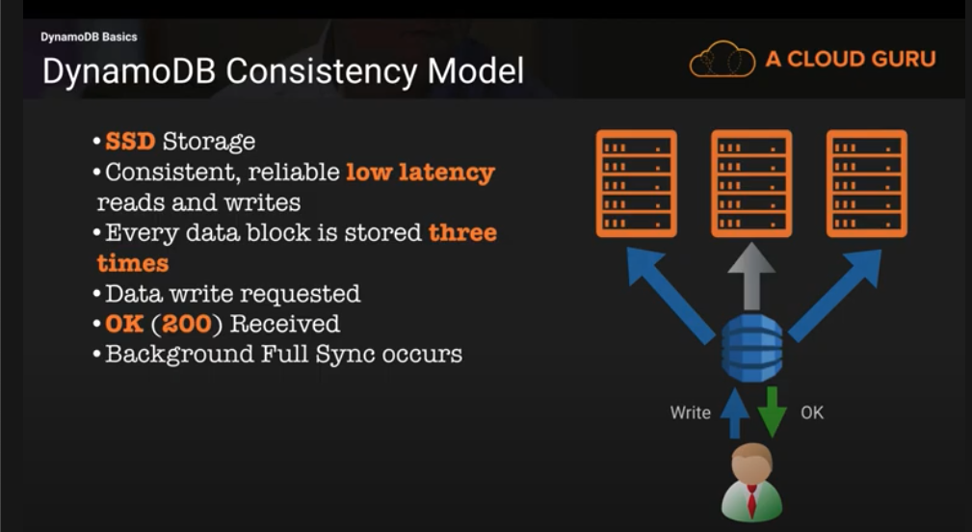
DynamoDB Model

Slide 51
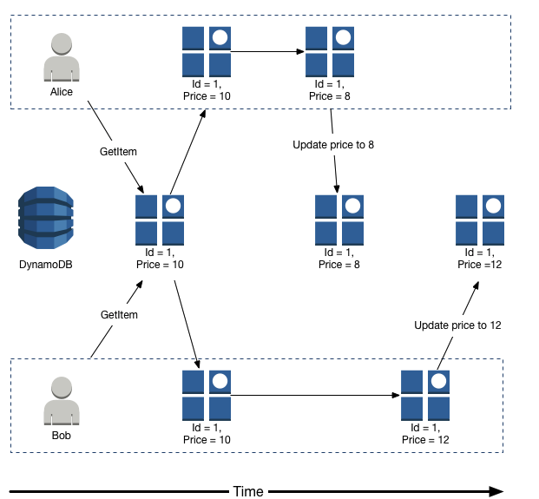
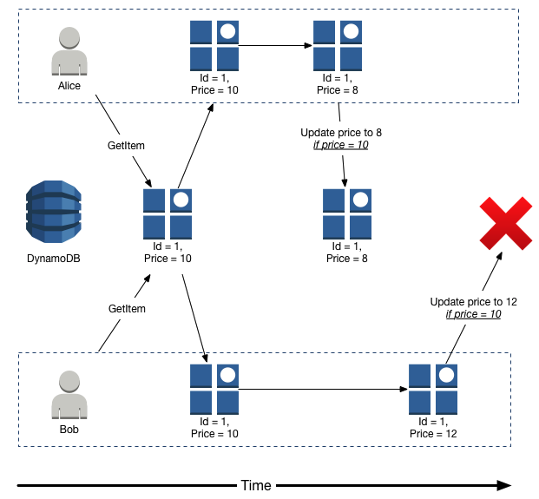
DynamoDB Conditional Writes
Write-Write Conflict: Lost Update
Write-Write Conflict: Fail and Retry

Slide 52
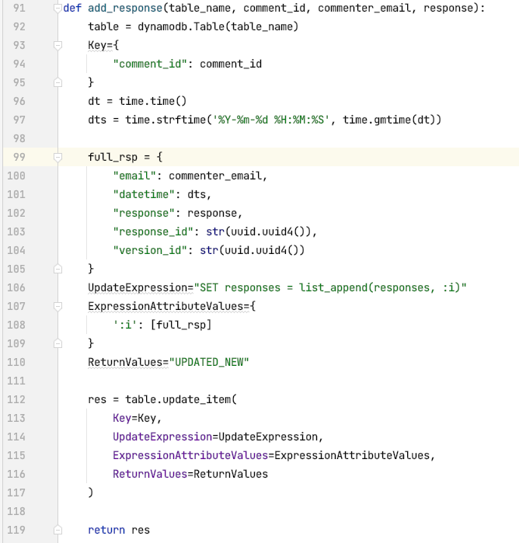
DynamoDB Update Expression
Increased concurrency is possible with more flexible operations.
CRUD requires READ and then UPDATE
Some datatypes and database support more flexible operations:
Add to list
Add/subtract from a number
etc.
In many cases these operations do not conflict, and is more flexible than X-locks.

Slide 53
Scalability Availability
53 | COMS W4111_002_2024_1 - Lecture 12: Module II (5), NoSQL (5), Big Data © Donald F. Ferguson, 2024

Slide 54
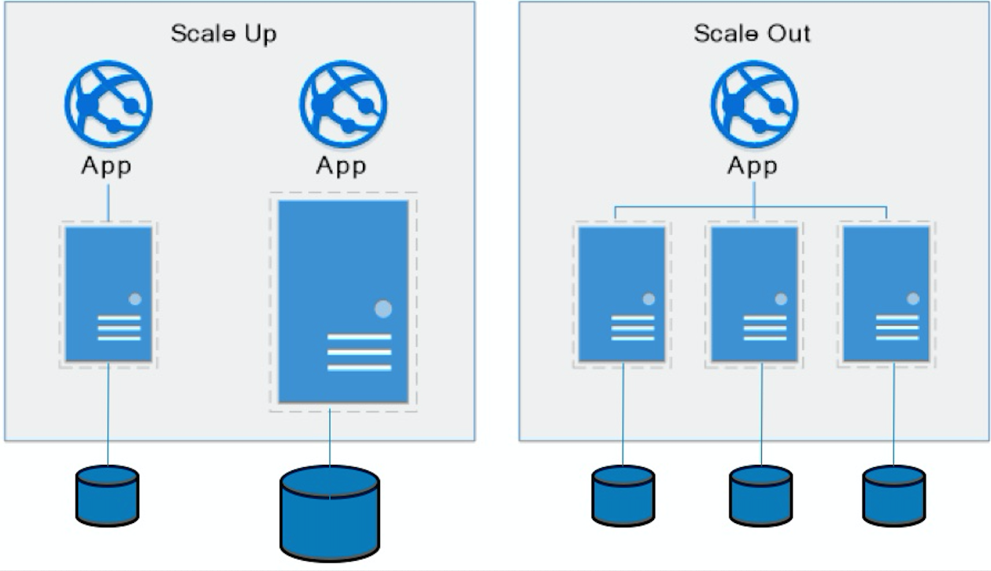
Approaches to Scalability
Scalability is the property of a system to handle a growing amount of work by adding resources to the system.
Replace system with a bigger machine, e.g. more memory, CPU, ... ...
Scale-up:
Less incremental.
More disruptive.
More expensive for extremely large systems.
Does not improve availability
Scale-out:
Incremental cost.
Data replication enables availability.
Does not work well for functions like JOIN, referential integrity, ... ...
Add another system.

Slide 55
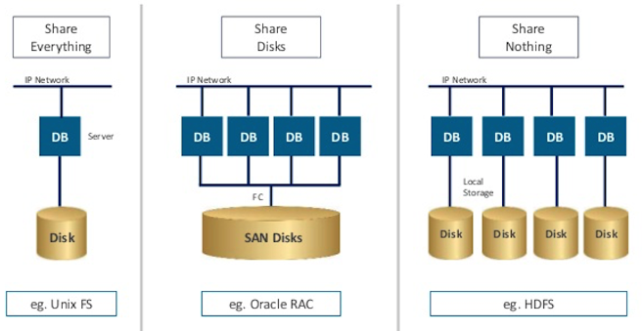
Disk Architecture for Scale-Out
Share disks:
Is basically scale-up for data/disks. You can use NAS, SAN and RAID.
Isolation/Integrity requires distributed locking to control access from multiple database servers.
Share nothing:
Is basically scale-out for disks.
Data is partitioned into shards based on a function f() applied to a key.
Can improve availability, at the code consistency, with data replication.
There is a router that sends requests to the proper shard based on the function.

Slide 56
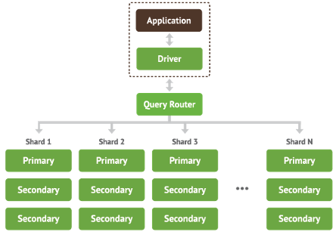
Shared Nothing, Scale-Out
MongoDB Sharding
DynamoDB Partitioning

Slide 57
Data Enablement Decision Support

Slide 58
Overview
Transactions Isolation Recovery

Slide 59
Overview
Data analytics: the processing of data to infer patterns, correlations, or models for prediction
Primarily used to make business decisions
Per individual customer
E.g., what product to suggest for purchase
Across all customers
E.g., what products to manufacture/stock, in what quantity
Critical for businesses today

Slide 60
Overview (Cont.)
Common steps in data analytics
Gather data from multiple sources into one location
Data warehouses also integrated data into common schema
Data often needs to be extracted from source formats, transformed to common schema, and loaded into the data warehouse
Can be done as ETL (extract-transform-load), or ELT (extract-load-transform)
Generate aggregates and reports summarizing data
Dashboards showing graphical charts/reports
Online analytical processing (OLAP) systems allow interactive querying
Statistical analysis using tools such as R/SAS/SPSS
Including extensions for parallel processing of big data
Build predictive models and use the models for decision making

Slide 61
Overview (Cont.)
Predictive models are widely used today
E.g., use customer profile features (e.g. income, age, gender, education, employment) and past history of a customer to predict likelihood of default on loan
and use prediction to make loan decision
E.g., use past history of sales (by season) to predict future sales
And use it to decide what/how much to produce/stock
And to target customers
Other examples of business decisions:
What items to stock?
What insurance premium to change?
To whom to send advertisements?

Slide 62
Overview (Cont.)
Machine learning techniques are key to finding patterns in data and making predictions
Data mining extends techniques developed by machine-learning communities to run them on very large datasets
The term business intelligence (BI) is synonym for data analytics
The term decision support focuses on reporting and aggregation

Slide 63
Enterprise Information Integration ETL
Data Warehouse, Data Lake
Transactions Isolation Recovery

Slide 64
Enterprise Information Integration

Slide 65
Data Warehouse and Data Lake

Slide 66
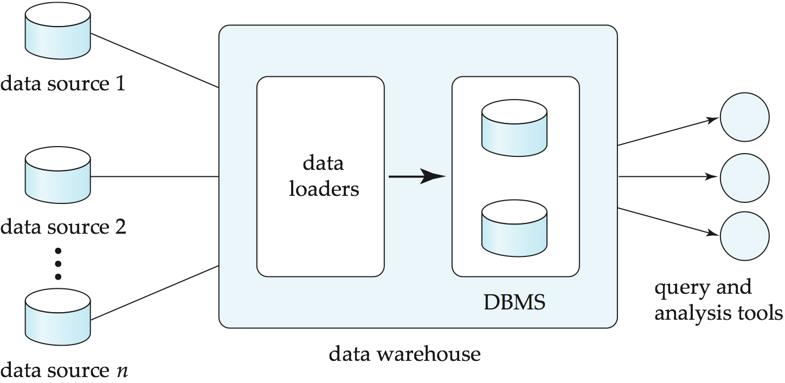
Data Warehousing

Slide 67
Overview (Cont.)
Common steps in data analytics
Gather data from multiple sources into one location
Data warehouses also integrated data into common schema
Data often needs to be extracted from source formats, transformed to common schema, and loaded into the data warehouse
Can be done as ETL (extract-transform-load), or ELT (extract-load-transform)
Generate aggregates and reports summarizing data
Dashboards showing graphical charts/reports
Online analytical processing (OLAP) systems allow interactive querying
Statistical analysis using tools such as R/SAS/SPSS
Including extensions for parallel processing of big data
Build predictive models and use the models for decision making

Slide 68
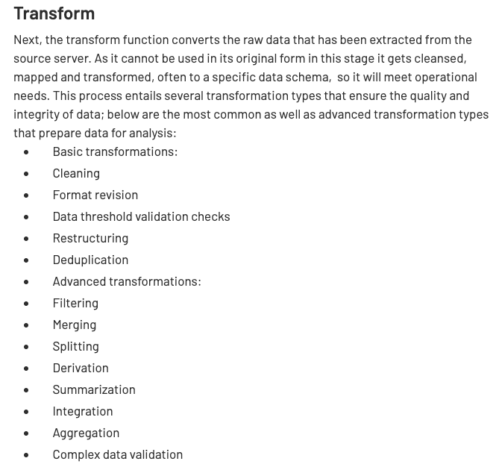
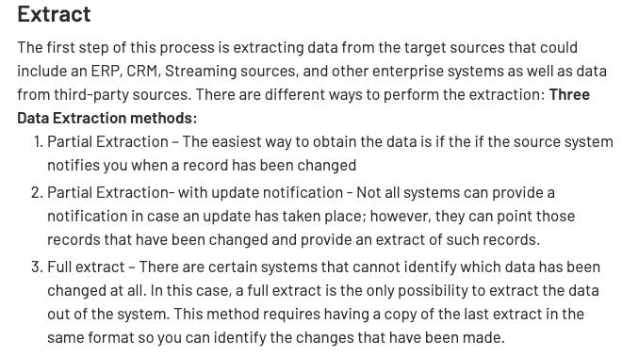
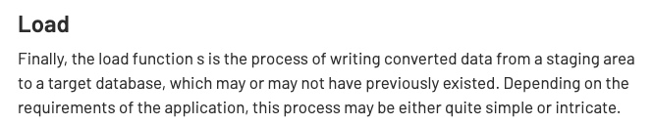
ETL Concepts
https://databricks.com/glossary/extract-transform-load

Slide 69
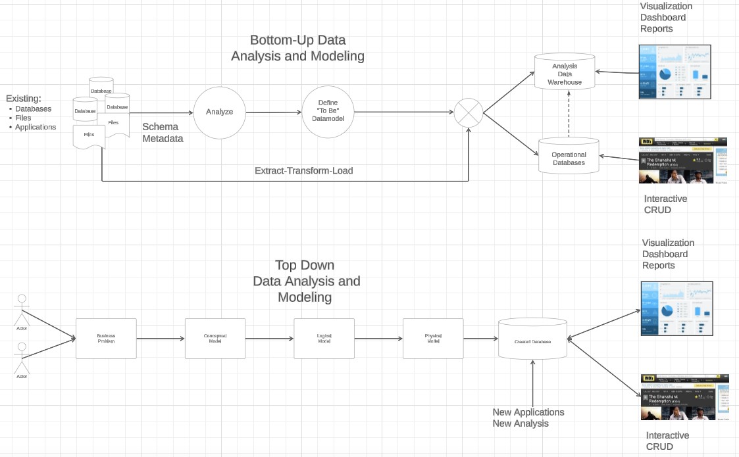
IMDB and GoT Data Processing

Slide 70
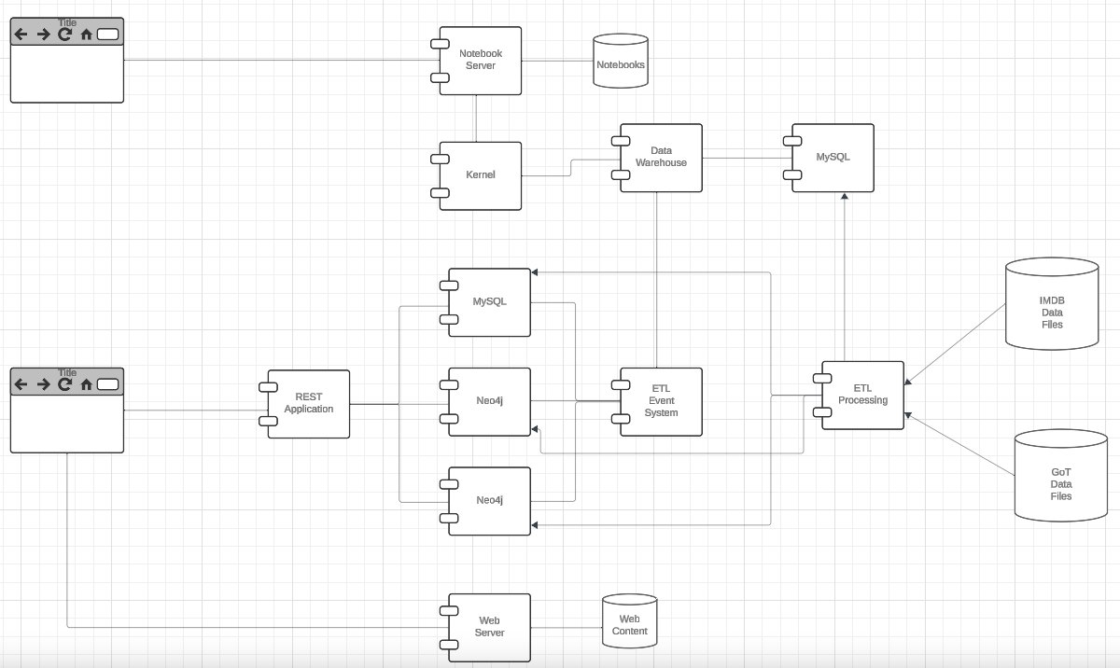
IMDB and GoT System

Slide 71
Mapreduce Spark
Transactions Isolation Recovery

Slide 72
MapReduce
MapReduce is a data flow program with relatively simple operators on the data set.
op1
op2
op3
With each operator implemented in parallel on multiple nodes for performance.
What is we want more complex “operators?”

Slide 73
Algebraic Operations
Current generation execution engines
natively support algebraic operations such as joins, aggregation, etc. natively.
Allow users to create their own algebraic operators
Support trees of algebraic operators that can be executed on multiple nodes in parallel
E.g. Apache Tez, Spark
Tex provides low level API; Hive on Tez compiles SQL to Tez
Spark provides more user-friendly API
In the relational model,
The are relations.
A fixed set of operators that produce relations from relations (closed).
Are declarative languages and compute the execution graph/plan.
The Spark/... ... engines:
Enable programmers to develop and add new operators.
Operators convert reliable distributed datasets/data frames to new RDDs/data frames.
Data engineer explicitly defines the execution graph (data flow).

Slide 74
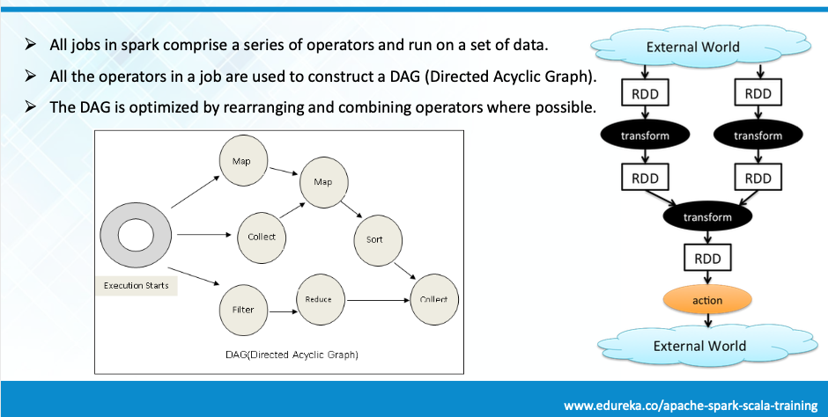
Spark

Slide 75
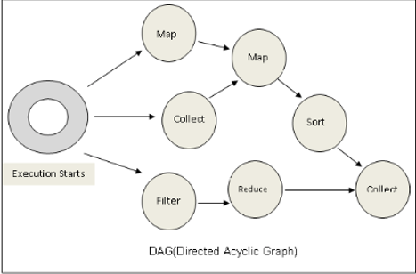
Spark
Conceptually similar to query evaluation graph, but ...
You explicitly define the graph.
You can develop your own operators.

Slide 76
Algebraic Operations in Spark
Resilient Distributed Dataset (RDD) abstraction
Collection of records that can be stored across multiple machines
RDDs can be created by applying algebraic operations on other RDDs
RDDs can be lazily computed when needed
Spark programs can be written in Java/Scala/R
Our examples are in Java
Spark makes use of Java 8 Lambda expressions; the code
s - > Arrays.asList(s.split(" ")).iterator()
defines unnamed function that takes argument s and executes the expression Arrays.asList(s.split(" ")).iterator() on the argument
Lambda functions are particularly convenient as arguments to map, reduce and other functions

Slide 77
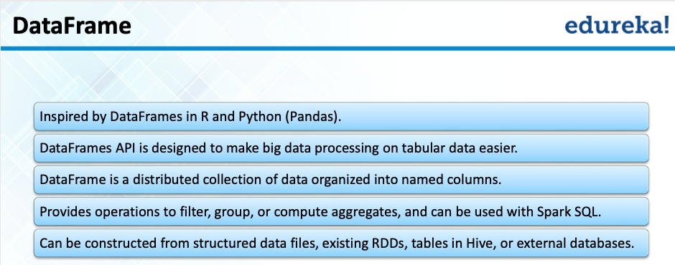
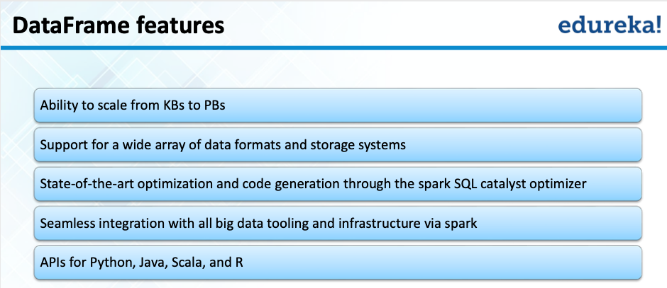
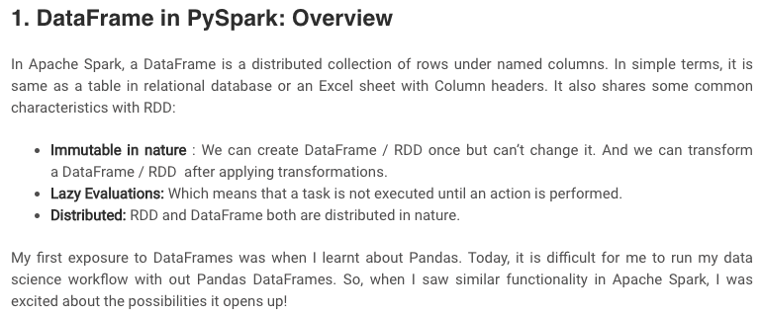
Spark/PySpark
https://www.analyticsvidhya.com/blog/2016/10/spark-dataframe-and-operations/

Slide 78
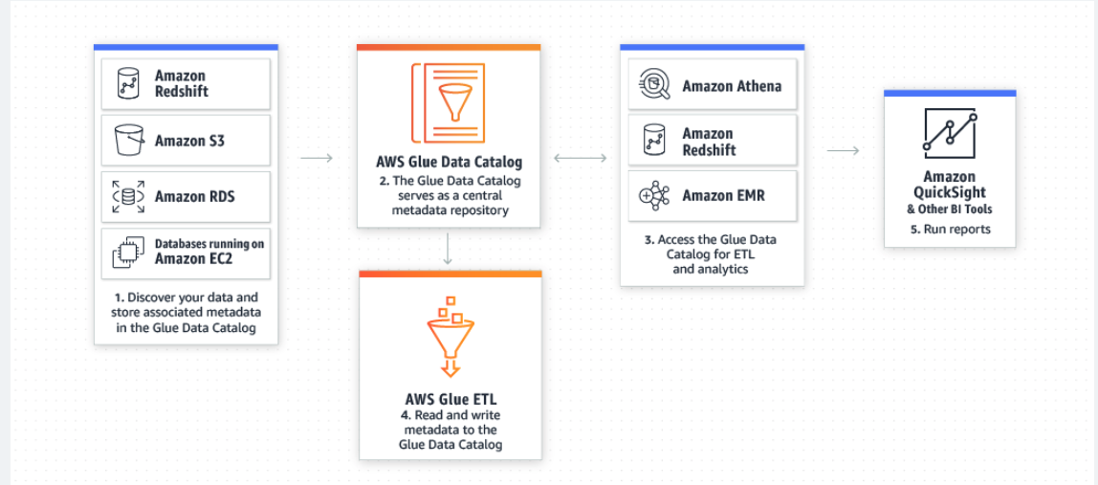
AWS Glue Supports Spark
AWS Glue is a serverless data preparation service that makes it easy for data engineers, extract, transform, and load (ETL) developers, data analysts, and data scientists to extract, clean, enrich, normalize, and load data.

Slide 79
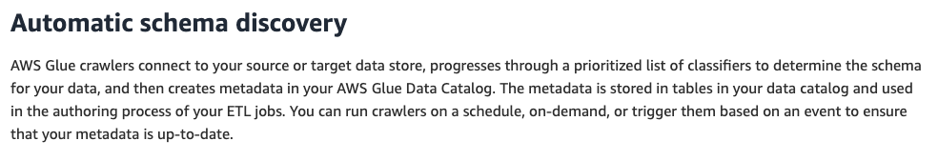
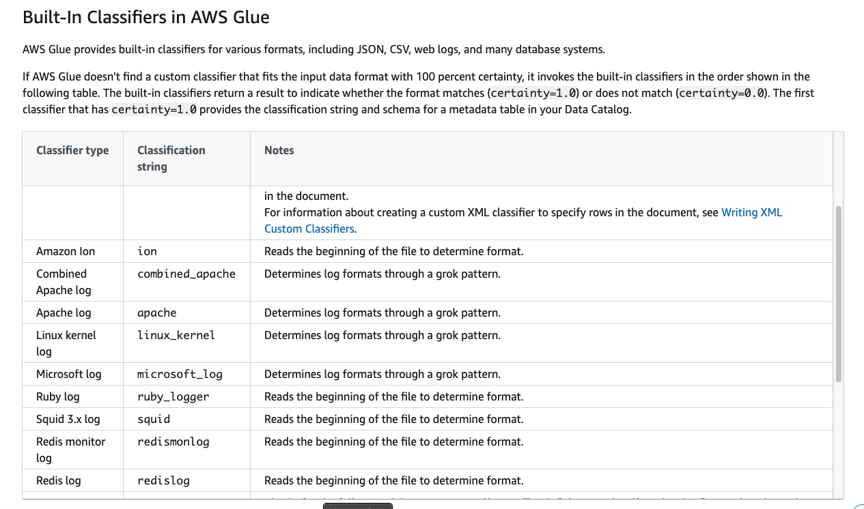
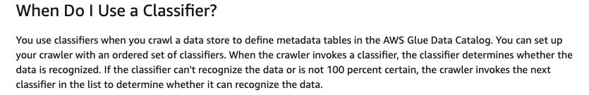
Crawlers/Classifiers

Slide 80
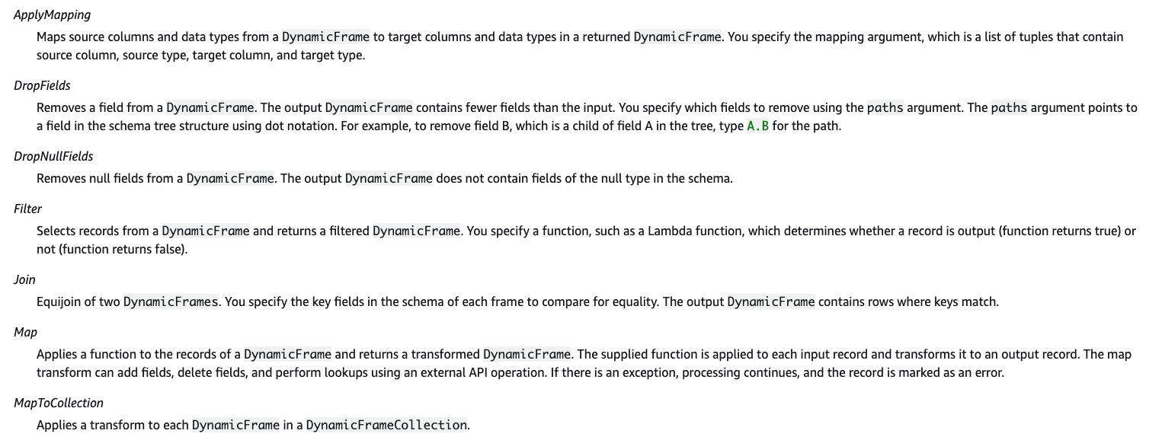
Built-In Transforms

Slide 81
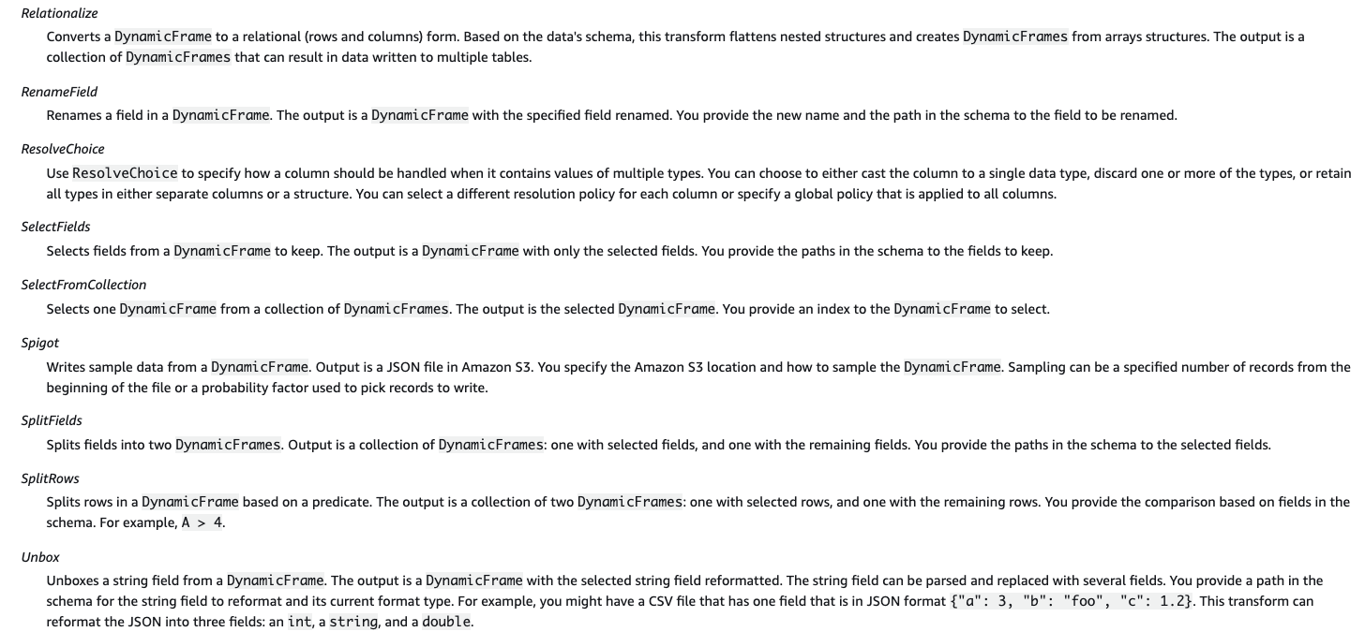
Built-In Transforms

Slide 82
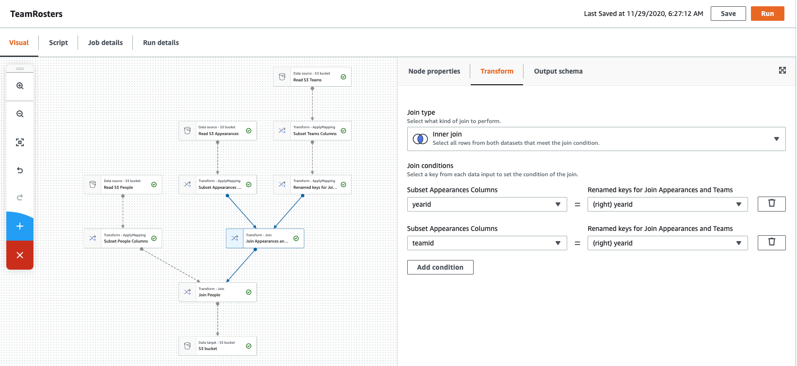
Visual Tools (There are similar tools for SQL, ETL, ... ...)

Slide 83
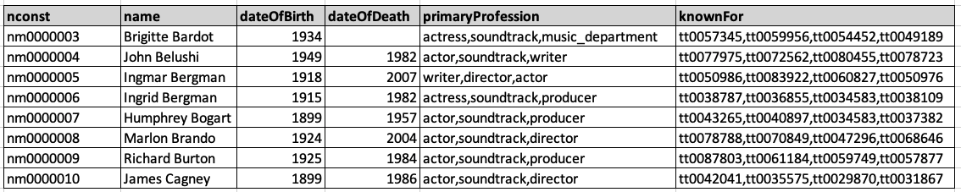
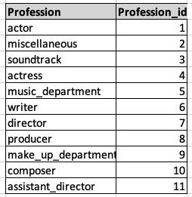
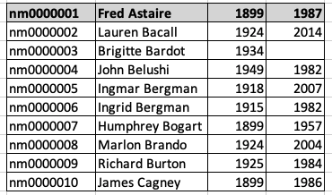
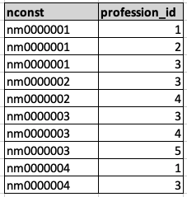
Conceptual Example
Consider the IMDB dataset. We should convert (other conversion needed)
To

Slide 84
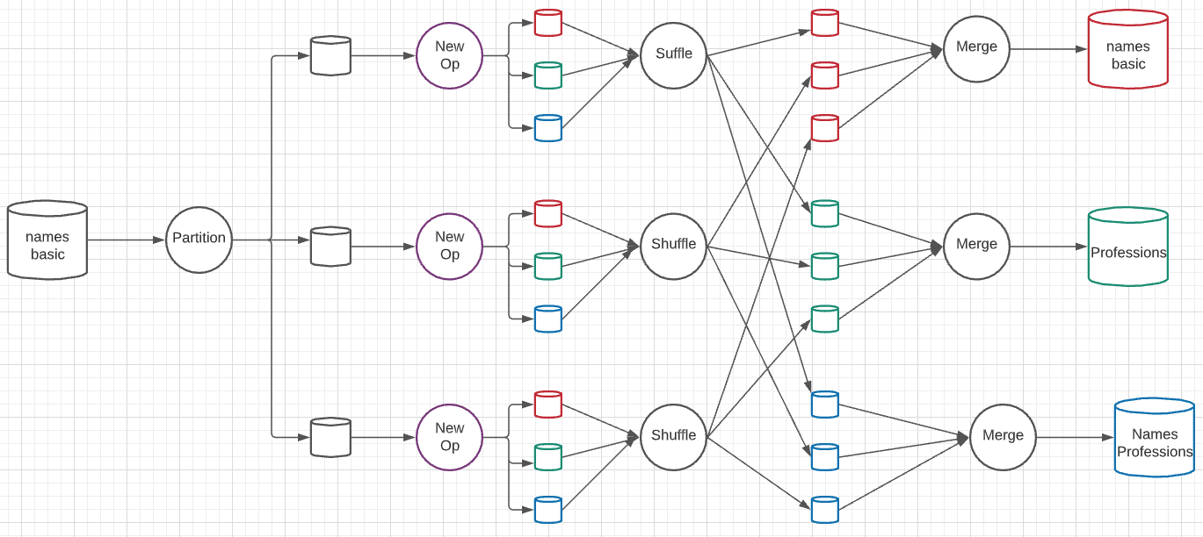
A New Algebraic Operator
Parallelism level is 3 simultaneous services at each stage.
Input is a dataset and column ID
Output is three datasets: dataset with column removed, table of distinct column values, associative entity.

Slide 85
OLAP
85 | COMS W4111_002_2024_1 - Lecture 12: Module II (5), NoSQL (5), Big Data © Donald F. Ferguson, 2024

Slide 86
Data Analysis and OLAP
Online Analytical Processing (OLAP)
Interactive analysis of data, allowing data to be summarized and viewed in different ways in an online fashion (with negligible delay)
We use the following relation to illustrate OLAP concepts
sales (item_name, color, clothes_size, quantity)
This is a simplified version of the sales fact table joined with the dimension tables, and many attributes removed (and some renamed)

Slide 87
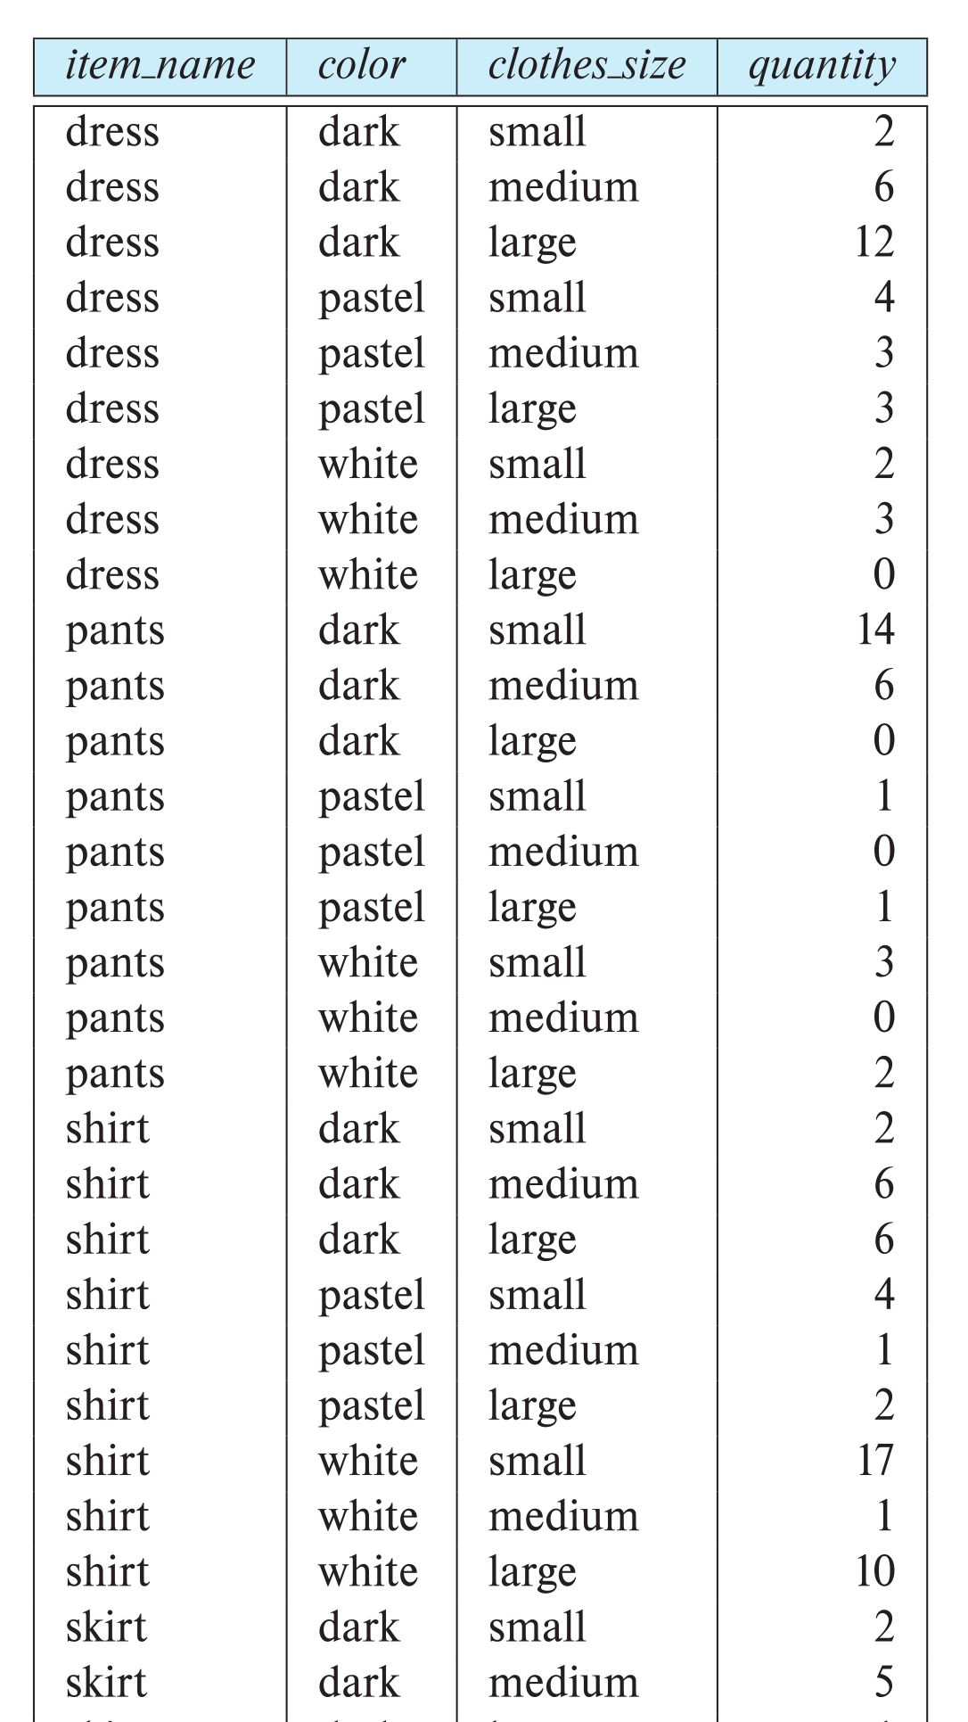
Example sales relation
...
...
...
...
...
...
...
...

Slide 88
Cross Tabulation of sales by item_name and color
The table above is an example of a cross-tabulation (cross-tab), also referred to as a pivot-table.
Values for one of the dimension attributes form the row headers
Values for another dimension attribute form the column headers
Other dimension attributes are listed on top
Values in individual cells are (aggregates of) the values of the dimension attributes that specify the cell.

Slide 89
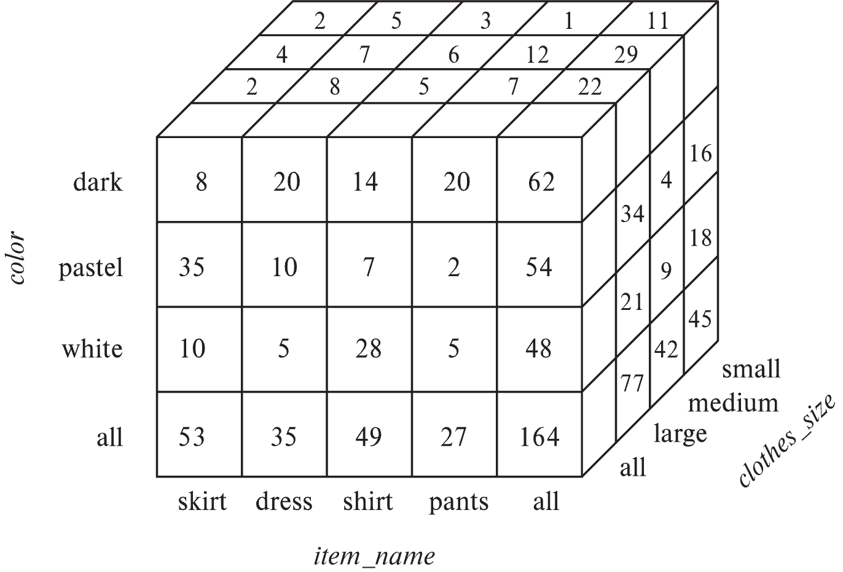
Data Cube
A data cube is a multidimensional generalization of a cross-tab
Can have n dimensions; we show 3 below
Cross-tabs can be used as views on a data cube

Slide 90
Online Analytical Processing Operations
Pivoting: changing the dimensions used in a cross-tab
E.g., moving colors to column names
Slicing: creating a cross-tab for fixed values only
E.g., fixing color to white and size to small
Sometimes called dicing, particularly when values for multiple dimensions are fixed.
Rollup: moving from finer-granularity data to a coarser granularity
E.g., aggregating away an attribute
E.g., moving from aggregates by day to aggregates by month or year
Drill down: The opposite operation - that of moving from coarser-granularity data to finer-granularity data

Slide 91
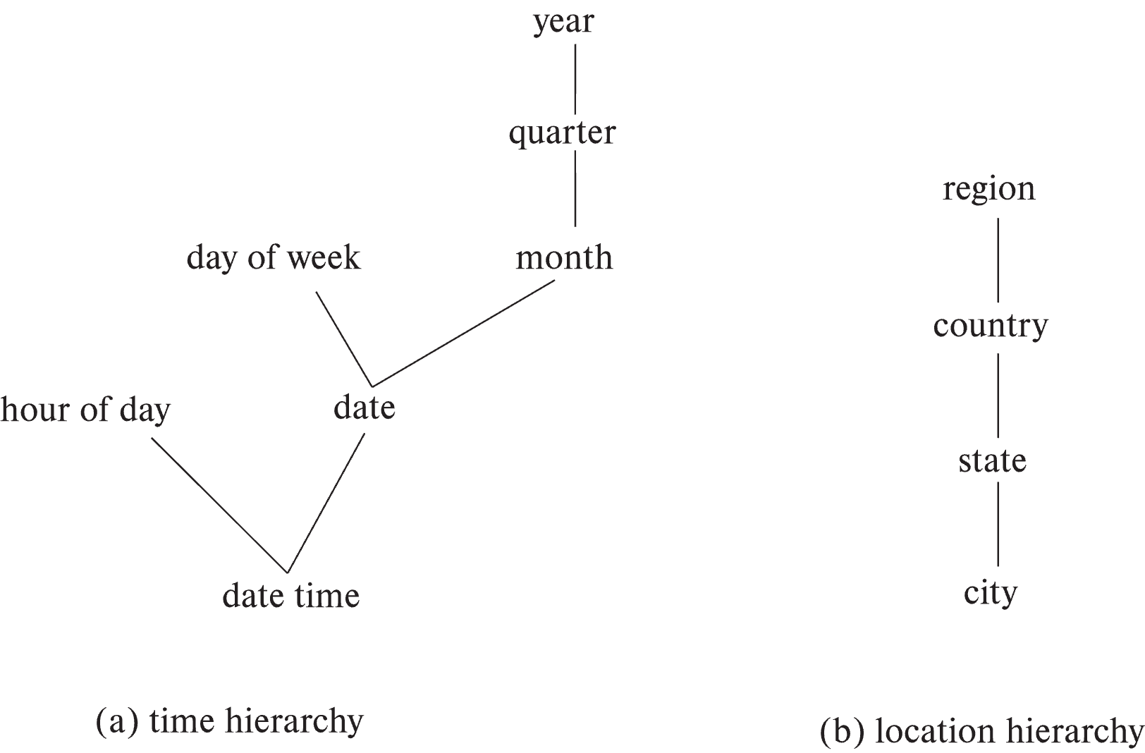
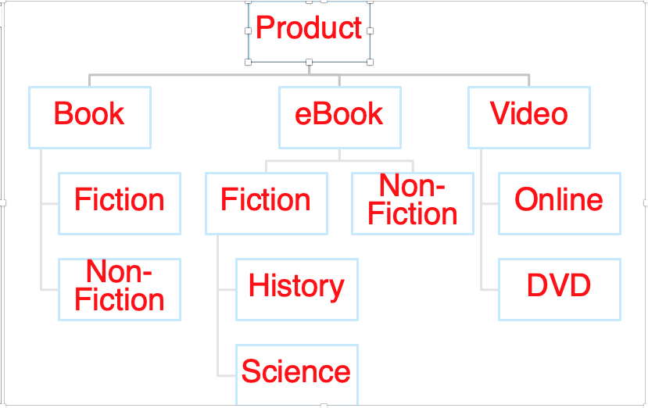
Hierarchies on Dimensions
Hierarchy on dimension attributes: lets dimensions be viewed at different levels of detail
E.g., the dimension datetime can be used to aggregate by hour of day, date, day of week, month, quarter or year
Another dimension could be ... Product category.

Slide 92
Another Dimension Example – Product Categories
Product
Book
eBook
Video
Fiction
Non-Fiction
Non-
Fiction
Fiction
Online
DVD
History
Science

Slide 93
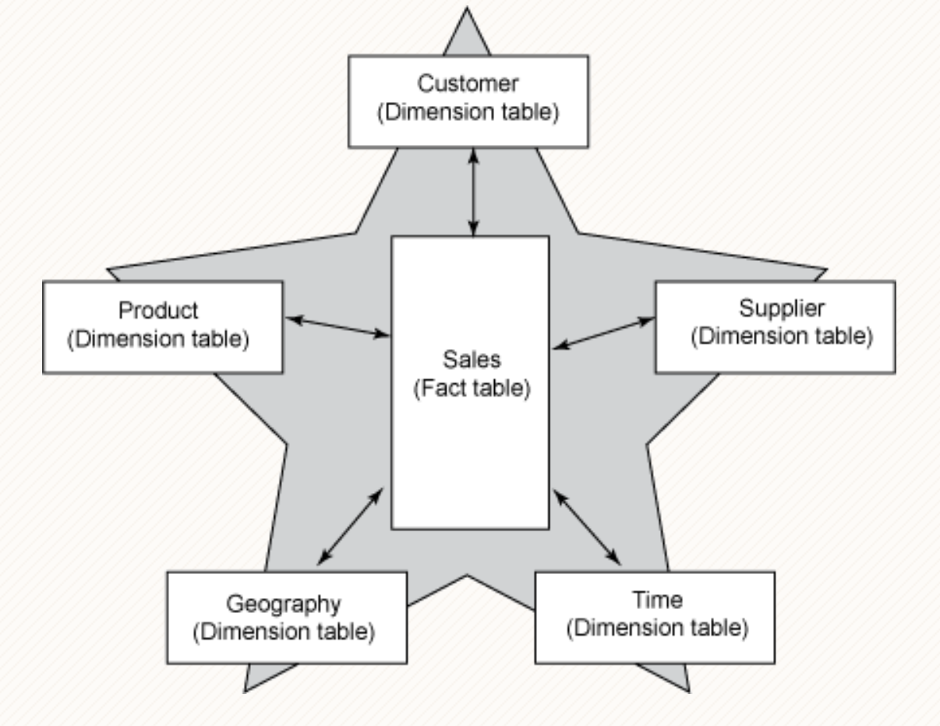
Facts and Dimensions

Slide 94
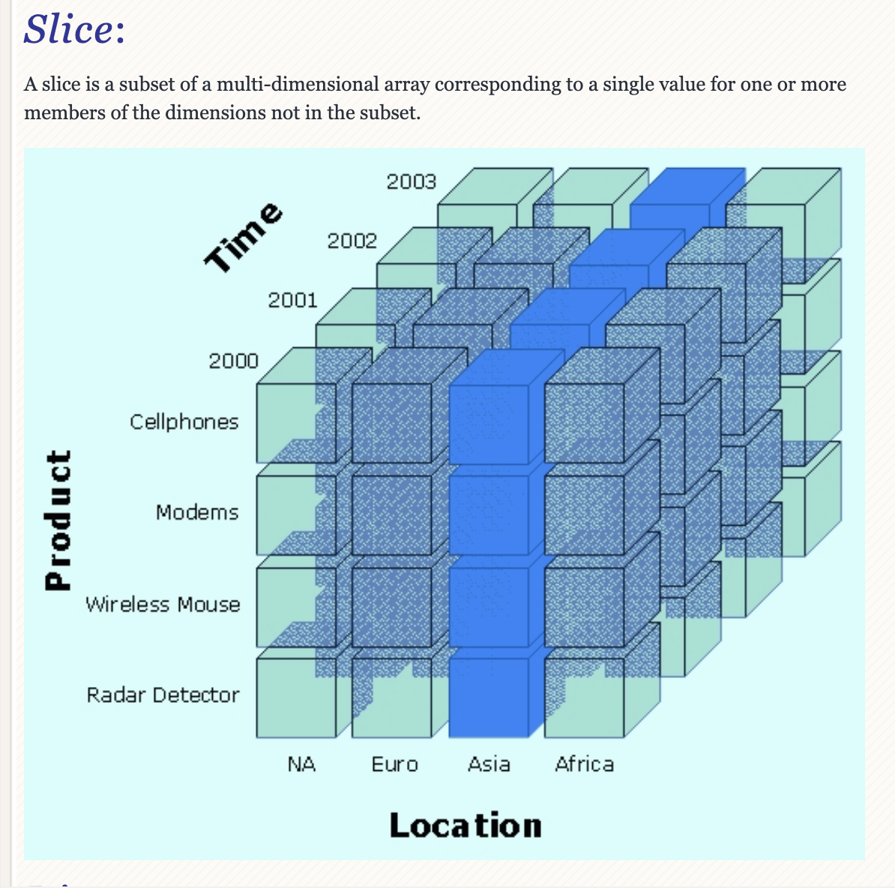
Slice

Slide 95
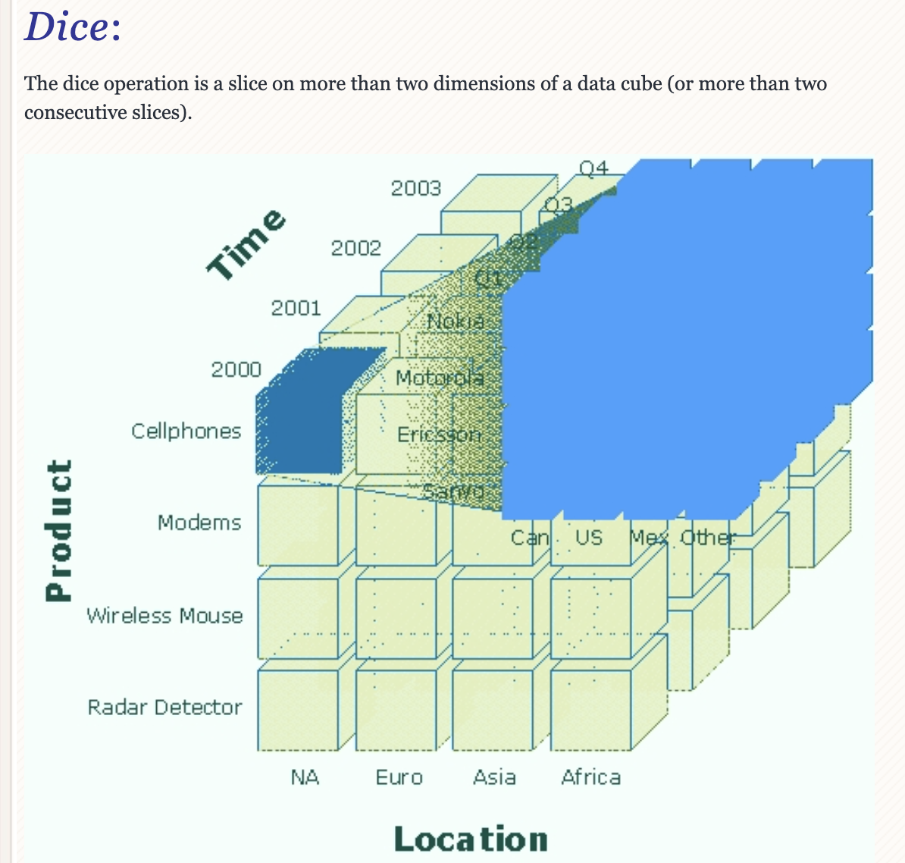
Dice

Slide 96
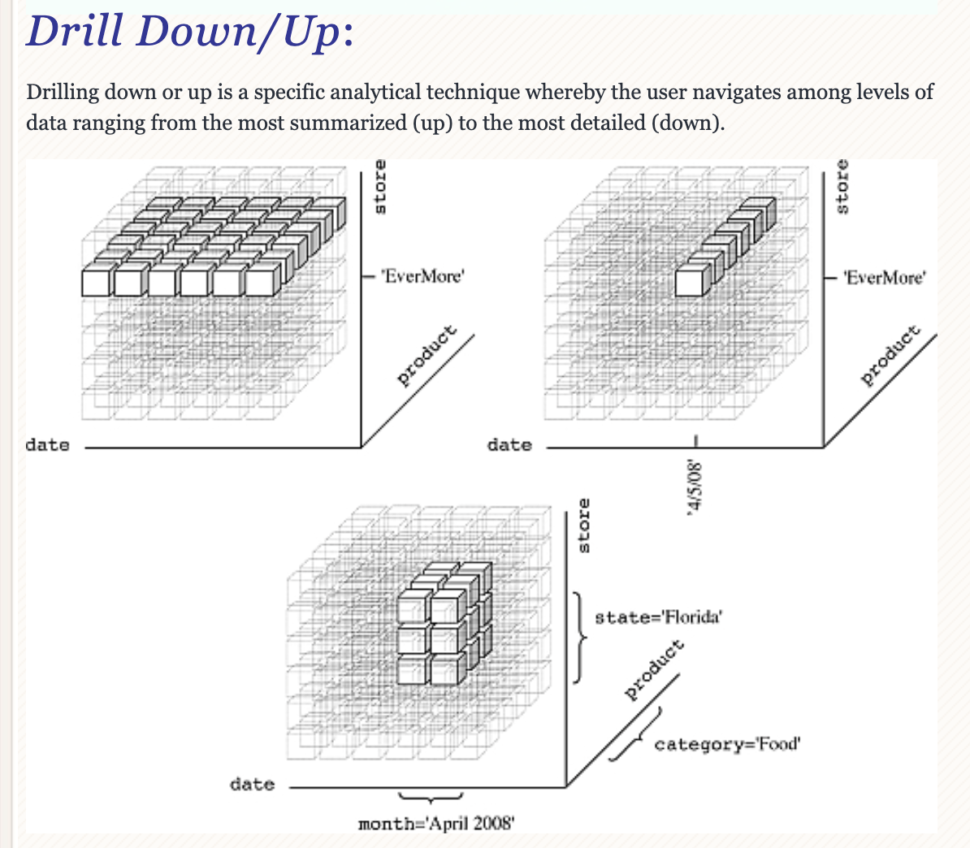
Drilling

Slide 97
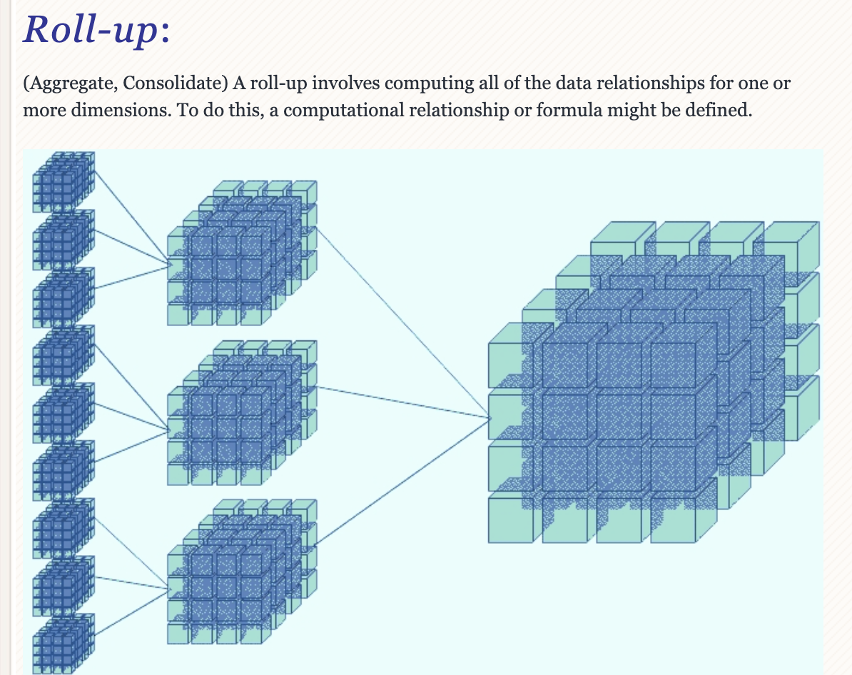
Roll-up

Slide 98
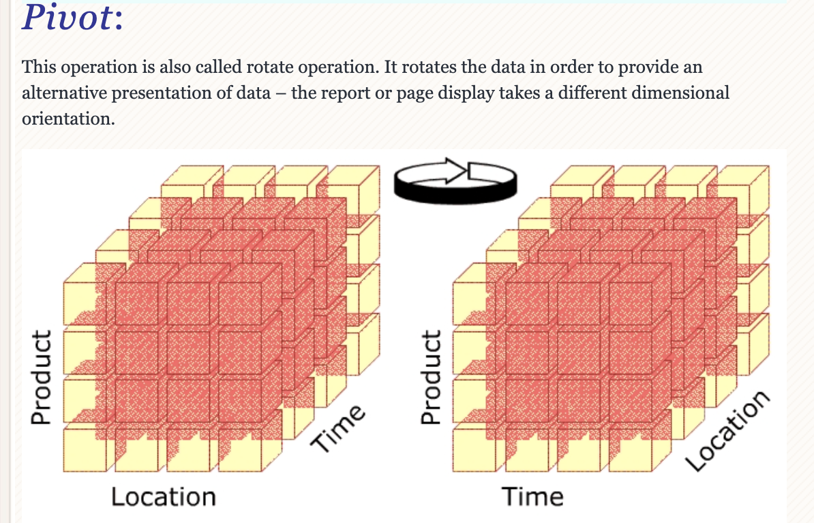
Pivot

Slide 99
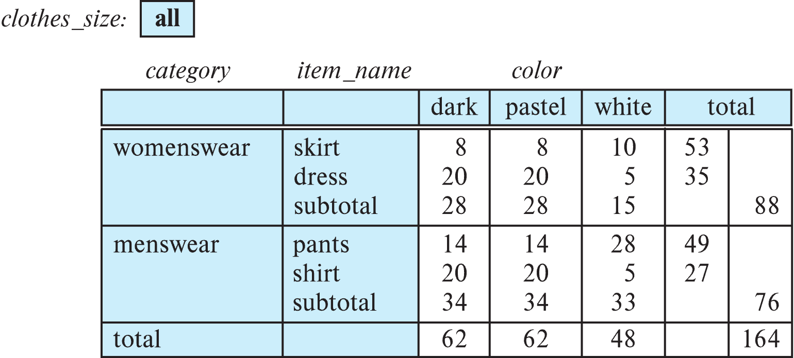
Cross Tabulation With Hierarchy
Cross-tabs can be easily extended to deal with hierarchies
Can drill down or roll up on a hierarchy
E.g. hierarchy: item_name → category

Slide 100
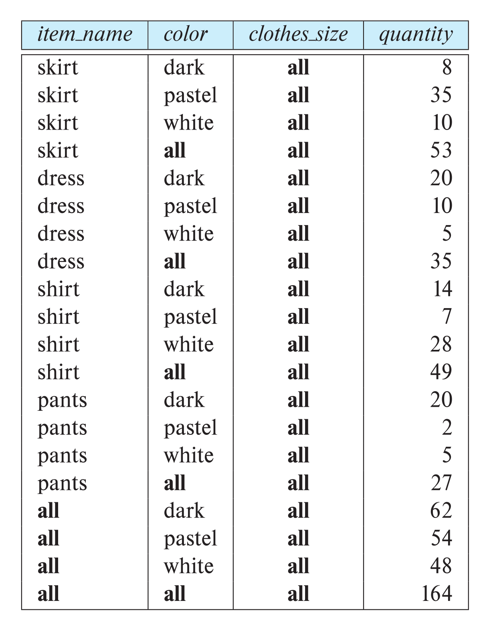
Relational Representation of Cross-tabs
Cross-tabs can be represented as relations
We use the value all to represent aggregates.
The SQL standard actually uses null values in place of all
Works with any data type
But can cause confusion with regular null values.

